Slide 1
Chapter 4: Cryptographic Hash Functions and Digital Signatures
Message Authentication, Message Authentication Functions, Message Authentication Codes
Hash Functions, Properties of Hash functions, Applications of Hash Functions
Digital Signatures: Direct Digital Signatures, Arbitrated Digital Signature
Digital Signature Standard: The DSS Approach, Digital Signature Algorithm
Digital Signature Standard: The RSA Approach
Message Digests: MD4 and MD5
Secure Hash Algorithms: SHA-1 and SHA-2

Slide 2
MESSAGE AUTHENTICATION(security) REQUIREMENTS
In the context of communications across a network, the following attacks can be identified.
Disclosure: Release of message contents to any person or process not possessing the appropriate cryptographic key.
Traffic analysis: Discovery of the pattern of traffic between parties. In a connection-oriented application, the frequency and duration of connections could be determined. In either a connection-oriented or connectionless environment, the number and length of messages between parties could be determined.
Masquerade: Insertion of messages into the network from a fraudulent source.

Slide 3
MESSAGE AUTHENTICATION(security) REQUIREMENTS
This includes the creation of messages by an opponent that are purported to come from an authorized entity. Also included are fraudulent acknowledgments of message receipt or nonreceipt by someone other than the message recipient.
Content modification: Changes to the contents of a message, including insertion, deletion, transposition, and modification.
Sequence modification: Any modification to a sequence of messages between parties, including insertion, deletion, and reordering.
Timing modification: Delay or replay of messages.

Slide 4
MESSAGE AUTHENTICATION(security) REQUIREMENTS
Source repudiation: Denial of transmission of message by source.
Destination repudiation: Denial of receipt of message by destination.

Slide 5
How to deal with these?
Measures to deal with the first two attacks are in the realm of message confidentiality.
Measures to deal with items (3) through (6) in the foregoing list are generally regarded as message authentication.
Mechanisms for dealing specifically with item (7) come under the heading of digital signatures. Generally, a digital signature technique will also counter some or all of the attacks listed under items (3) through (6).
Dealing with item (8) may require a combination of the use of digital signatures and a protocol designed to counter this attack.

Slide 6
Conclusion
message authentication is a procedure to verify that received messages come from the alleged source and have not been altered. Message authentication may also verify sequencing and timeliness.
A digital signature is an authentication technique that also includes measures to counter repudiation by the source.

Slide 7
MESSAGE AUTHENTICATION FUNCTIONS
Types of functions that may be used to produce an authenticator. These may be grouped into three classes.
Hash function: A function that maps a message of any length into a fixed length hash value, which serves as the authenticator.
Message encryption: The ciphertext of the entire message serves as its authenticator.
Message authentication code (MAC): A function of the message and a secret key that produces a fixed-length value that serves as the authenticator

Slide 8
Message Encryption
Message encryption by itself can provide a measure of authentication.
SYMMETRIC ENCRYPTION
PUBLIC-KEY ENCRYPTION

Slide 9
SYMMETRIC ENCRYPTION
A message transmitted from source A to destination B is encrypted using a secret key shared by A and B. If no other party knows the key, then confidentiality is provided: No other party can recover the plaintext of the message.
In addition, B is assured that the message was generated by A. Why? The message must have come from A, because A is the only other party that possesses K and therefore the only other party with the information necessary to construct ciphertext that can be decrypted with K.

Slide 11
PUBLIC-KEY ENCRYPTION
The straightforward use of public-key encryption (fig.b) provides confidentiality but not authentication. The source (A) uses the public key PU_{b} of the destination (B) to encrypt M. Because only B has the corresponding private key PR_{b} , only B can decrypt the message. This scheme provides no authentication, because any opponent could also use B’s public key to encrypt a message and claim to be A.

Slide 12
How to provide authentication with public key?
To provide authentication, A uses its private key to encrypt the message, and B uses A’s public key to decrypt (Figure. c).This provides authentication using the same type of reasoning as in the symmetric encryption case: The message must have come from A because A is the only party that possesses PRa and therefore the only party with the information necessary to construct ciphertext that can be decrypted with PUa .

Slide 13
To provide both confidentiality and authentication using public key
To provide both confidentiality and authentication, A can encrypt M first using its private key, which provides the digital signature, and then using B’s public key, which provides confidentiality (Figure d).
The disadvantage of this approach is that the public-key algorithm, which is complex, must be exercised four times rather than two in each communication.

Slide 14
Message Authentication Code
An alternative authentication technique involves the use of a secret key to generate a small fixed-size block of data, known as a cryptographic checksum or MAC, that is appended to the message.
This technique assumes that two communicating parties, say A and B, share a common secret key K. When A has a message to send to B, it calculates the MAC as a function of the message and the key:
MAC = C(K, M)
Where M= Input message , K=shared secret key, C=MAC function, MAC=Message Authentication Code

Slide 15
Message Authentication Code
So, Generated by an algorithm that creates a small fixed-sized blocks.
Depend on both message and some key.
Like encryption though need not be reversible.
The message plus MAC are transmitted to the intended recipient
Receiver performs same computation on the received message, using the same secret key to generate a new MAC. The received MAC is compared to the calculated MAC (Figure a).

Slide 16
If we assume that only the receiver and the sender know the identity of the secret key, and if the received MAC matches the calculated MAC, then
The receiver is assured that the message has not been altered. If an attacker alters the message but does not alter the MAC, then the receiver’s calculation of the MAC will differ from the received MAC. Because the attacker is assumed not to know the secret key, the attacker cannot alter the MAC to correspond to the alterations in the message.
The receiver is assured that the message is from the alleged sender. Because no one else knows the secret key, no one else could prepare a message with a proper MAC.

Slide 17
If the message includes a sequence number (such as is used with HDLC,X.25, and TCP), then the receiver can be assured of the proper sequence because an attacker cannot successfully alter the sequence number.
MAC is many to one function i.e. many messages have same MAC.

Slide 18
Digital Signatures
The most important development from the work on public-key cryptography is the digital signature.
Message authentication protects two parties who exchange messages from any third party. However, it does not protect the two parties against each other i.e. have looked at message authentication but does not address issues of lack of trust.
Digital signatures provide the ability to:
verify author, date & time of signature.
authenticate message contents .
be verified by third parties to resolve disputes.
Hence include authentication function with additional capabilities

Slide 19
Digital signatures employ a type of Asymmetric Cryptography. The Scheme typically consists of three Algorithms
A key generation algorithm that selects a private key uniformly at random from a set of possible private keys. The algorithm outputs the private key and a corresponding public key.
A signing algorithm that, given a message and a private key, produces a signature.
A signature verifying algorithm that, given a message, public key and a signature, either accepts or rejects the message's claim to authenticity

Slide 20
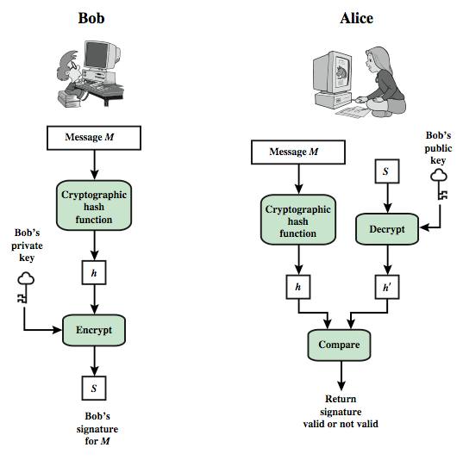
Digital Signature Model Digital Signature Model

Slide 21
DIRECT Digital Signatures
Direct Digital Signatures involve the direct application of public-key algorithms involving only the communicating parties. (involve only sender & receiver).
A digital signature may be formed by encrypting the entire message with the sender’s private key, or by encrypting a hash code of the message with the sender’s private key.
Confidentiality can be provided by further encrypting the entire message plus signature using either public or private key schemes.
It is important to perform the signature function first and then an outer confidentiality function, since in case of dispute, some third party must view the message and its signature.
But these approaches are dependent on the security of the sender’s private-key.

Slide 22
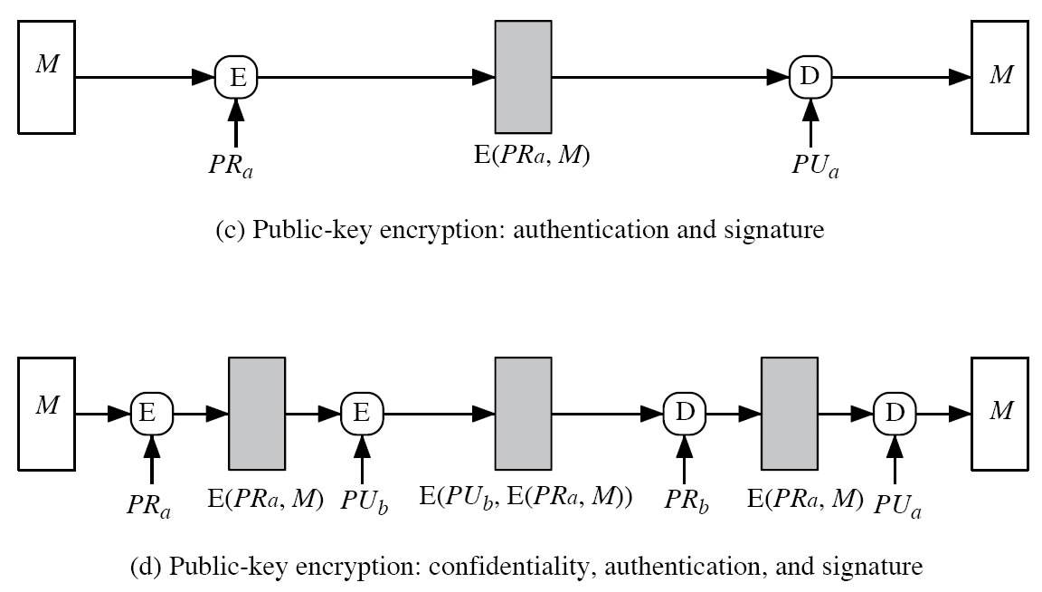
Direct Digital Signatures
Weakness: Security depends on sender’s private-key

Slide 23
DIRECT Digital Signatures
Problems with direct signatures:
Validity of scheme depends on the security of the sender’s private key ⇒ sender may later deny sending a certain message.
Private key may actually be stolen from X at time T, so timestamp may not help.

Slide 24
Arbitrated Digital Signatures
In the arbitrated signature scheme, there is a trusted third party called the arbiter.
Every signed message from a sender X to a receiver Y goes first to an arbiter A, who subjects the message and its signature to a number of tests to check its origin and content.
The message is then dated and sent to Y with an indication that it has been verified to the satisfaction of the arbiter.
The presence of A solves the problem faced by direct signature schemes, namely that X might deny sending a message. The arbiter plays a sensitive and crucial role in this scheme, and all parties must trust that the arbitration mechanism is working properly.

Slide 25
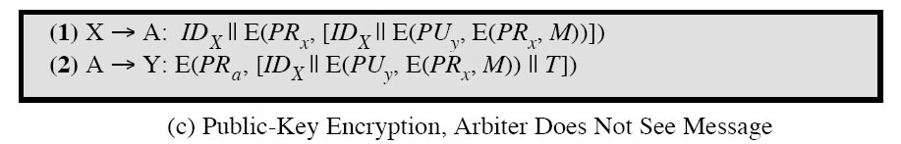
Arbitrated Digital Signatures
Notations:
X=sender M=message
Y=recipient T=time stamp
A=Arbiter PR_{X}=X’s private key
ID_{X}=ID of X PU_{Y}=Y’s public key
PR_{A}=A’s private key
Weakness: twice public-key encryptions on the message

Slide 26
Digital Signature Requirements
Must depend on the message signed.
Must use information unique to sender
Must be relatively easy to produce
Must be relatively easy to recognize & verify
Directed : Recipient can verify
Arbitrated: Anyone can verify
Be computationally infeasible to forge
Be able to retain a copy of the signature in storage

Slide 27
Digital Signature Standard (DSS)
US Govt approved signature scheme
Designed by NIST & NSA in early 90's
Published as FIPS-186 in 1991
Revised in 1993, 1996 & then 2000
Uses the SHA hash algorithm
DSS is the standard, DSA is the algorithm

Slide 28
A public versus a private approach to digital signatures
Another way of classifying digital signature schemes is based on whether a private-key system or a public-key system is used.
The public-key system based digital signatures have several advantages over the private-key system based digital signatures.
The two most popular and commonly used public-key system based digital signature schemes are the RSA (named after Rivest, Shamir, and Aldeman, the inventors of the RSA public-key encryption scheme) and the digital signature algorithm (DSA) approaches.

Slide 29
The DSA is incorporated into the Digital Signature Standard (DSS), which was published by the National Institute of Standards and Technology as the Federal Information Processing Standard. It was first proposed in 1991, revised in 1993, and further revised with minor changes in 1996.

Slide 30
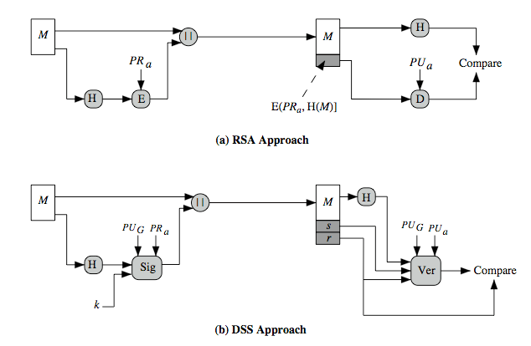
DSS vs. RSA Signatures

Slide 31
RSA Scheme
The message to be signed is input to a hash function that produces a secure hash code of fixed length.
This hash code is then encrypted using the sender's private key to form the signature.
Both the message and the signature are then transmitted.
The recipient takes the message and produces a hash code.
The recipient also decrypts the signature using the sender's public key.
If the calculated hash code matches the decrypted signature, the signature is accepted as valid. Because only the sender knows the private key, only the sender could have produced a valid signature.

Slide 32
DSS

Slide 33
DSS Scheme
makes use of a hash function.
The hash code is provided as input to a signature function along with a random number k generated for this particular signature.
The signature function also depends on the sender's private key (PRa)and a set of parameters known to a group of communicating principals. We can consider this set to constitute a global public key (PU_{G}).

Slide 34
DSS Scheme
The result is a signature consisting of two components, labeled s and r.
At the receiving end, the hash code of the incoming message is generated. This plus the signature is input to a verification function. The verification function also depends on the global public key as well as the sender's public key (PUa), which is paired with the sender's private key.
The output of the verification function is a value that is equal to the signature component r if the signature is valid. The signature function is such that only the sender, with knowledge of the private key, could have produced the valid signature.

Slide 35
The Digital Signature Algorithm (DSA)
Global Public-Key Components
p
A prime number of L bits where L is a multiple of 64 and 512 ≤ L ≤ 1024
q
A 160-bit prime factor of p-1
g
= h^{(p-1)/q} mod p, where h is any integer with 1<h< p-1, such that (h^{(p-1)/q} mod p)>1
User’s Private Key
x
A random or pseudorandom integer with 0<x<q
User’s Public Key
y
= g^{x} mod p
User’s Per-Message Secret Number
k
A random or pseudorandom integer with 0<k<q
Signing
r = (g^{k} mod p) mod q s = [k⁻¹ (H(M) = xr)] mod q
Signature = (r, s)
Verifying
w = (s’)⁻¹ mod q
u₁ = [H(M’)w] mod q u₂ = (r’)w mod q v = [(g^{u1}y^{u2}) mod p] mod q Test: v = r’

Slide 36
DSS
DSA - M = message to be signed - H(M) = hash of M using SHA - M’, r’, s’ = received versions of M, r, s

Slide 37
Example DSA
p = 23 # computed prime modulus: (p-1) mod q = 0
q=11, which is prime divisor/factor of p-1 i.e. (23-1=22)
g=4

Slide 38
Digital signatures applications
Digital signatures are being used in secure e-mail and credit card transactions over the Internet. The two most common secure e-mail systems using digital signatures are Pretty Good Privacy and Secure/Multipurpose Internet Mail Extension. Both of these systems support the RSA as well as the DSS-based signatures.
The most widely used system for the credit card transactions over the Internet is Secure Electronic Transaction (SET). It consists of a set of security protocols and formats to enable prior existing credit card payment infrastructure to work on the Internet.

Slide 39
Hashes
A hash value h is generated by a function H of the form h = H(M)
where M is a variable-length message and H(M) is the fixed-length hash value.
The hash value is appended to the message at the source at a time when the message is assumed or known to be correct.
The receiver authenticates that message by recomputing the hash value. Because the hash function itself is not considered to be secret, some means is required to protect the hash value

Slide 40
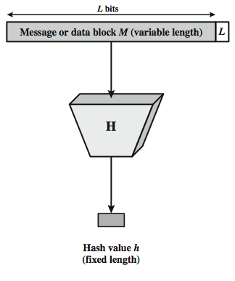

Slide 41
Requirements for a Hash Function
H can be applied to a block of data of any size.
H produces a fixed-length output.
H(x) is relatively easy to compute for any given x, making both hardware and software implementations practical.
For any given value h, it is computationally infeasible to find x such that H(x) = h. This is sometimes referred to in the literature as the one-way property.
For any given block x, it is computationally infeasible to find y ≠ x such that H(y) = H(x). This is sometimes referred to as weak collision resistance.
It is computationally infeasible to find any pair (x, y) such that H(x) = H(y). This is sometimes referred to as strong collision resistance.

Slide 42
Applications
Message Integrity Verification: Determining whether any changes have been made to a message (or a file), for example, can be accomplished by comparing message digests calculated before, and after, transmission (or any other event).

Slide 43
Applications
Password Verification: Passwords are usually not stored in cleartext, for obvious reasons, but instead in digest form. To authenticate a user, the password presented by the user is hashed and compared with the stored hash. This is sometimes referred to as one-way encryption.
Digital Signatures:
while generating digital signatures, the message digest is created and it is encrypted with the private key so that the signing process becomes faster.

Slide 44
HMAC (keyed-Hash Message Authentication Code)
A keyed-Hash Message Authentication Code (HMAC or KHMAC), is a type of message authentication code (MAC) calculated using a specific algorithm involving a cryptographic hash function in combination with a secret key.
It may be used to verify both the data integrity and the authenticity of a message.
Any iterative cryptographic hash function, like MD5 or SHA-1, may be used in HMAC; the resulting MAC algorithm is termed HMAC-MD5 or HMAC-SHA-1 accordingly.
The cryptographic strength of the HMAC depends upon the cryptographic strength of the underlying hash function, on the size and quality of the key and the size of the hash output length in bits.

Slide 45
HMAC
A MAC derived from hash function is called HMAC.
The reason for developing HMAC were that hash functions incur less overhead than encryption and the code of hash functions is easily and freely available.
HMAC is a great resistant towards cryptanalysis attacks as it uses the Hashing concept twice.
HMAC consists of twin benefits of Hashing and MAC, and thus is more secure than any other authentication codes.

Slide 46
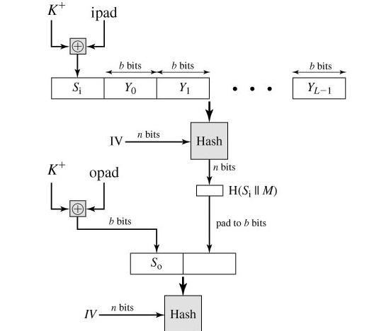


Slide 47
H = embedded hash function (e.g., MD5, SHA-1, RIPEMD-160)
IV = initial value input to hash function.
M = message input to HMAC (including the padding specified in the embedded hash function).
Y_{i} = i^{th} block of M, 0 ≤ i ≤ (L – 1).
L = number of blocks in M.
b = number of bits in a block.
n =length of hash code produced by embedded hash function.
K = secret key; recommended length is n; if key length is greater than b,the key is input to the hash function to produce an n-bit key.

Slide 48
K+ =K padded with zeros on the left so that the result is b bits in length.
ipad =00110110 (36 in hexadecimal) repeated b/8 times.
opad 01011100 (5C in hexadecimal) repeated b/8 times.

Slide 49
How algorithm works (Description)?
Append zeros to the left end of K to create a b-bit string K⁺ .
XOR (bitwise exclusive-OR) K⁺ with ipad to produce the b-bit block S_{i} .
Append M to S_{i} .
Apply H to the stream generated in step 3.
XOR K⁺ with opad to produce the b-bit block S₀ .
Append the hash result from step 4 to S₀ .
Apply H to the stream generated in step 6 and output the result.

Slide 50
Then HMAC can be expressed as follows:
HMAC(K,M) = H[(K⁺ XOR opad)||H[(K⁺ XOR ipad)||M]]

Slide 51
Examples of Hash Functions
MD2
Snefru = Fast hash named after Egyptian king !
MD4 = Message Digest 4
Snefru 2 = Designed after Snefru was broken !
MD5 = Message Digest 5
SHA = Secure hash algorithm !
SHA-1 = Updated SHA !
SHA-2 = SHA-224, SHA-256, SHA-384, SHA-512 SHA-512 uses 64-bit operations !
HMAC = Keyed-Hash Message Authentication Code

Slide 52
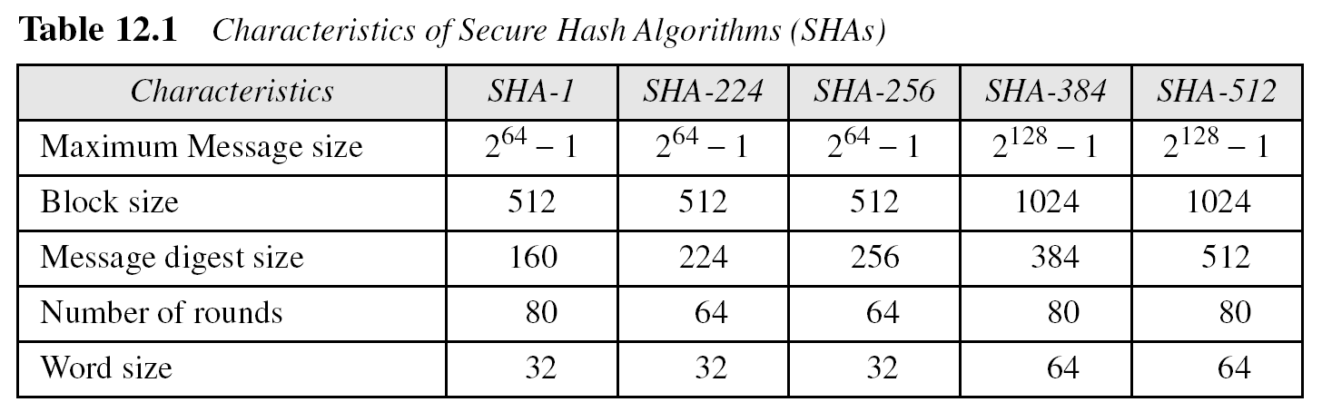
Different Message digest algorithms

Slide 53
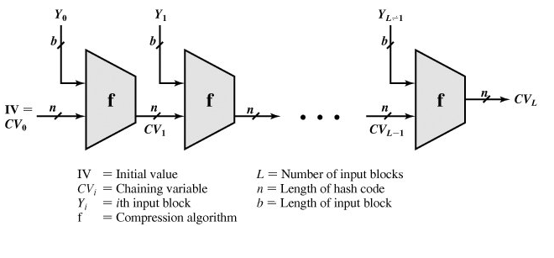
General Structure of Secure Hash Code

Slide 54
General Structure of Secure Hash Code
This structure, referred to as an iterated hash function, was proposed by Merkle and is the structure of most hash functions in use today, including SHA and Whirlpool.
The hash function takes an input message and partitions it into L fixed-sized blocks of b bits each.
If necessary, the final block is padded to b bits.
The final block also includes the value of the total length of the input to the hash function.
The inclusion of the length makes the job of the opponent more difficult. Either the opponent must find two messages of equal length that hash to the same value or two messages of differing lengths that, together with their length values, hash to the same value

Slide 55
If the compression function is collision resistant, then the resultant iterated hash function is also collision resistant and hence secure.
Thus, the problem of designing a secure hash function is that of designing a collision-resistant compression function operates on inputs of some fixed size.

Slide 56
Secure Hash Algorithm
The Secure Hash Algorithm (SHA) was developed by the National Institute of Standards and Technology (NIST) and published as a federal information processing standard (FIPS 180) in 1993; a revised version was issued as FIPS 180-1 in 1995 and is generally referred to as SHA-1.
SHA-1 produces a hash value of 160 bits.
In 2002, NIST produced a revised version of the standard, FIPS 180-2, that defined three new versions of SHA, with hash value lengths of 256, 384, and 512 bits, known as SHA-256, SHA-384, and SHA-512.
These new versions have the same underlying structure and use the same types of modular arithmetic and logical binary operations as SHA-1.

Slide 57
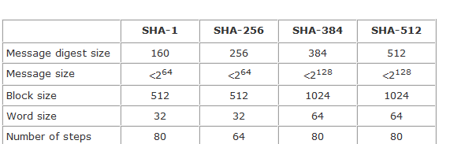
Comparison of SHA Parameters
Note: All sizes are measured in bits.

Slide 58
MEssage Digest Algorithms MD 4 (Message Digest 4)
MD 4 Algorithm is a cryptographic hash function developed by Ronald Rivest in 1990.
The MD4 message digest algorithm takes an input message of arbitrary length and produces an output 128-bit (four 32 bits words) "fingerprint" or "message digest“.
The MD4 algorithm is thus ideal for digital signature applications: a large file can be securely "compressed" with MD4 before being signed with (say) the RSA public-key cryptosystem.
It is optimized for 32-bit computers.

Slide 59
Terminology and Notation
A word is a 32-bit quantity and a byte is an 8-bit quantity.
Let the symbol “+” denote addition of words (i.e., modulo- 2³² addition).
Let (X <<< s) denote the 32-bit value obtained by circularly shifting (rotating) X left by s bit positions.
Let ¬X denote the bit-wise complement of X, and let X V Y denote the bit-wise OR of X and Y . Let X ⊕ Y denote the bit-wise XOR of X and Y , and let XY denote the bit-wise AND of X and Y .

Slide 60
Step 1: MD4 Message Padding
The message to be processed by MD4 computation must be multiple of 512 bits (16 32-bit words).
The original message is padded by adding 1 followed by required number of 0s so that the length of the message is 64 bits less than multiple of 512.
The remaining 64 bits is used for providing length of the original message i.e. unpadded message.

Slide 61
Original Message | 1000……………..000 | Original length in bits 64 bits
Padding is always performed, even if the length of the message is already congruent to 448, modulo 512 (in which case 512 bits of padding are added).
single “1” bit is appended to the message, and then enough zero bits are appended so that the length in bits of the padded message becomes congruent to 448, modulo 512.

Slide 62
Step 2. Append length
A 64-bit representation of b (the length of the message before the padding bits were added) is appended to the result of the previous step.
These bits are appended as two 32-bit words and appended low-order word first in accordance with the previous conventions.
At this point the resulting message (after padding with bits and with b) has a length that is an exact multiple of 512 bits. Equivalently, this message has a length that is an exact multiple of 16 (32-bit) words. Let M[0….. . N -1] denote the words of the resulting message, where N is a multiple of 16.

Slide 63
Step 3. Initialize MD buffer
A 4-word buffer (A, B , C, D) is used to compute the message digest.
Here each of A, B , C, D is a 32-bit register.
These registers are initialized to the following values (in hexadecimal, low-order bytes first) :
word A: 01 23 45 67
word B: 89 ab cd ef
word C: fe dc ba 98
word D: 76 54 32 10

Slide 64
Step 4. Process message in 16-word blocks:
We first define three auxiliary functions that each take as input three 32-bit words and produce as output one 32-bit word.
In each bit position f acts as a conditional: if x then y else z .
In each bit position g acts as a majority function: if at least two of x,y, z are one, then g has a one in that position.
The function h is the bit-wise xor or parity function.

Slide 65

MD 4 (Message Digest 4)
MD4 utilizes two “magic constants” in rounds two and three. The round two constant is $√$2 and the round constant is $√$3

Slide 66
Round1

Slide 67
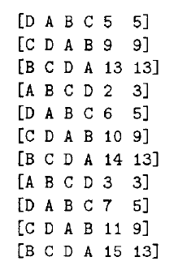
Round 2

Slide 68
Round3

Slide 69
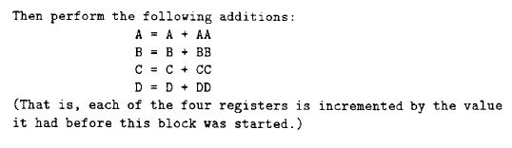
MD 4 (Message Digest 4)

Slide 70
MD 4 (Message Digest 4) Step 5. Output
The message digest produced as output is A, B, C, D. That is, we begin with the low-order byte of A , and end with the high-order byte of D.

Slide 71
MD5
MD5 or ”message digest 5” algorithm was designed by professor Ronald Rivest. Rivest is a professor in MIT who also invented RSA, RC5 and the MD-message digest hashing functions.
Rivest first designed MD2 for 8-bit machines in 1989. The original message is padded at first so that the total message is divisible by 16. Plus a 16-byte checksome is added to it to create a total 128-bit message digest or hash value. But collisions were for MD2 were found soon

Slide 72
Rivest then developed MD4 for 32-bit machines in 1990. MD4 influenced a lot of cryptographic hash functions such as MD5, SHA-1.
Same as MD2 collisions for MD4 were found soon enough. MD4 has been criticized even by Ronald Rivest because MD4 was designed to be fast which led to a lot of security risks.
MD5 was developed in 1991. MD5 is almost same as MD4 but with ”safety belts”. Its slower than MD4 but more secure. But over the years collisions were found in MD5. Den Boer and Bosselaers first found collision in MD5 in 1993. In March 2004 a project called MD5CRK was initiated to find collision in MD5 by using Birthday Attack

Slide 73
Description
MD5 creates a 128bit message digest from data input. The output must be unique from other message digests.
Initially designed for Digital signature.

Slide 74
MD5 Algorithm
Append Padding Bits
Append length bits
Initialize MD Buffer
Process each 512-bit block
Output message Digest

Slide 75
1. Append Padding Bits
In the first step, we add padding bits in the original message in such a way that the total length of the message is 64 bits less than the exact multiple of 512.
Suppose we are given a message of 1000 bits. Now we have to add padding bits to the original message. Here we will add 472 padding bits to the original message. After adding the padding bits the size of the original message/output of the first step will be 1472 i.e. 64 bits less than an exact multiple of 512 (i.e. 512*3 = 1536).
No matter the size of the message padding is always done. First a ’1’ bit is appended to the message and then a series of ’0’ bits.

Slide 76
For example with message of 400 bits

Slide 77
For example with message of 400 bits
For example if our message is 400 bits then we will add one ’1’ bit and 47 ’0’ bits which gives us 448 bits which is 64 bits shy of being divisible by 512.
If our message is 1200 bits in size than we will add one ’1’ bit and 271 ’0’ bits which gives us 1472 bits. 1472+64 is divisible by 512. At least 1 bit and at most 512 bits are padded or extended to the original message.

Slide 78
2. Append Length
The length bit is added in the output of the first step in such a way that the total number of the bits is the perfect multiple of 512. Simply, here we add the 64-bit as a length bit in the output of the first step.
i.e. output of first step=512*n-64
Length bits=64
After adding both we will get 512*n i.e. exact multiple of 512.
At this point the message is divided into blocks of 512 bits each. Each 512 bits block is divided into 16 words of 32-bits each. We denote the words as M[0.....N-1] where N is a multiple of 16.

Slide 79
3. Initialize MD Buffer
MD5 uses a four word buffer each 32-bits long. We denote them by A,B,C,D. These are pre-initialized as:

Slide 80
4. Process Each 512-bit Block
This is the most important step of the MD5 algorithm.
Here, a total of 64 operations are performed in 4 rounds.
In the 1st round, 16 operations will be performed, 2nd round 16 operations will be performed, 3rd round 16 operations will be performed, and in the 4th round, 16 operations will be performed.
A different function is applied on each round i.e. for the 1st round we apply the F function, for the 2nd G function, 3rd for the H function, and 4th for the I function.

Slide 81
F(X,Y,Z) = XY v not(X) Z
G(X,Y,Z) = XZ v Y not(Z)
H(X,Y,Z) = X xor Y xor Z
I(X,Y,Z) = Y xor (X v not(Z))

Slide 82
This step uses a 64-element table T[1 ... 64] constructed from the sine function. Let T[i] denote the i-th element of the table, which is equal to the integer part of 4294967296 times abs(sin(i)), where i is in radians. The elements of the table are given in the appendix.

Slide 83
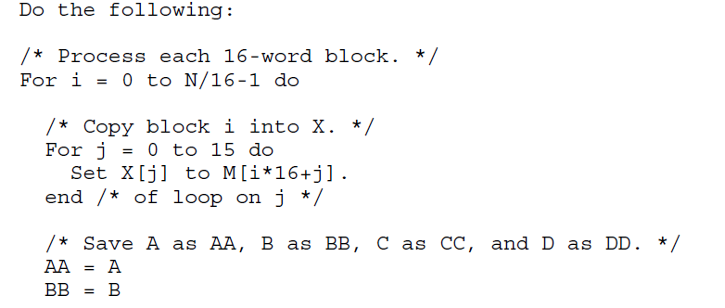
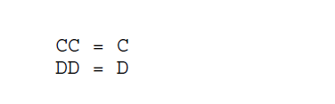

Slide 84
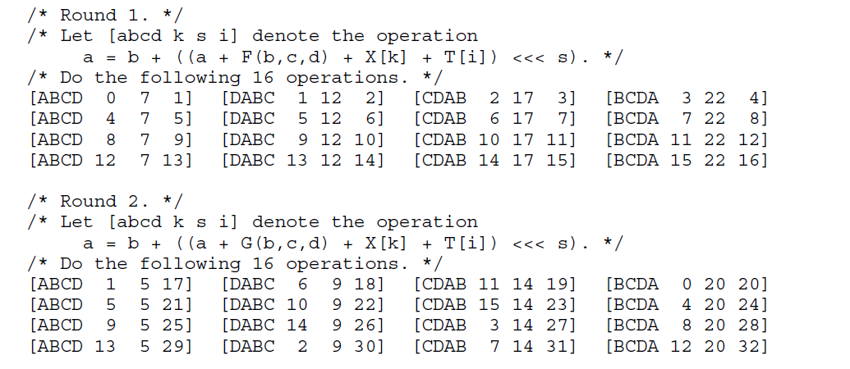

Slide 85
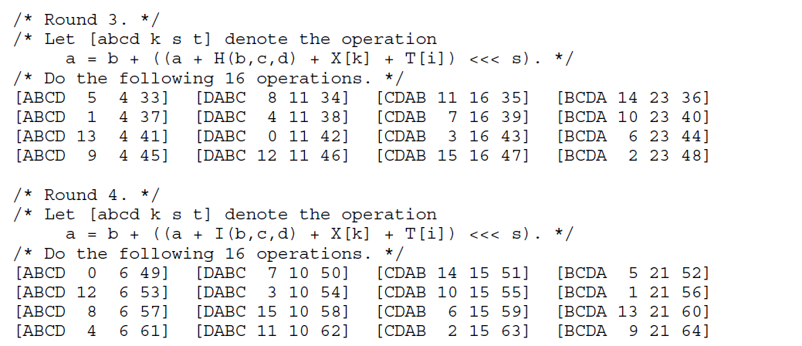

Slide 86
5. Output message Digest
After all, rounds have been performed,
A = A + AA
B = B + BB
C = C + CC
D = D + DD
After all operations the buffer, A,B,C,D contains MD5 digest of our input message.

Slide 87
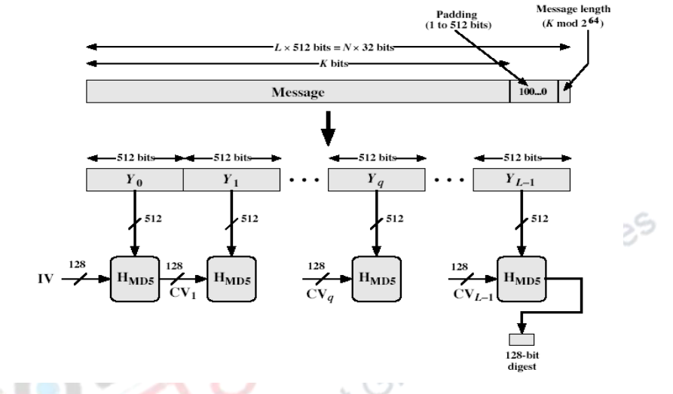
MD5 Overview

Slide 88
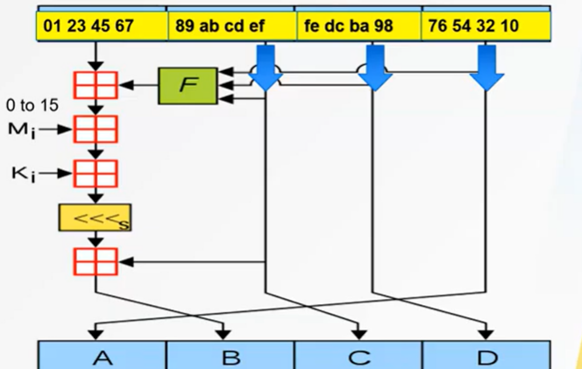

Figure 1. One MD5 operation. MD5 consists of 64 of these operations, grouped in four rounds of 16 operations. F is a nonlinear function; one function is used in each round. M_{i} denotes a 32-bit block of the message input, and K_{i} denotes a 32-bit constant, different for each operation. <<<_{s} denotes a left bit rotation by s places; s varies for each operation.
denotes addition modulo 2³².
The values for K are is derived from the formula:
abs(sin(i+ 1))×2³²
The MD5 operation is composed of
A nonlinear operation F;
A left-circular shift;
Addition (modulo 2³²) of constants {T_{i}}, and
Addition (modulo 2³²) of a 32-bit word {M_{i}} from the message to (A, B, C, D).
64 constants.
One of these K values is used in each of the 64 operations for a 512-bit block. K1 to K16 are used in the first round, K17 to K32 are used in the second round, K33 to K48 are used in the third round, and K49 to K64 are used in the fourth round.

Slide 89
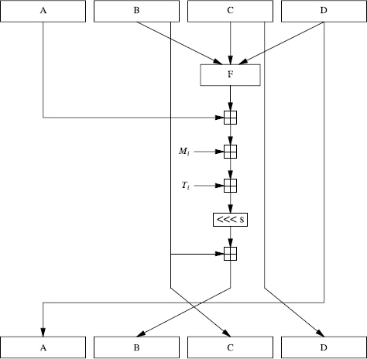
Figure Basic MD5 operation.

Slide 90
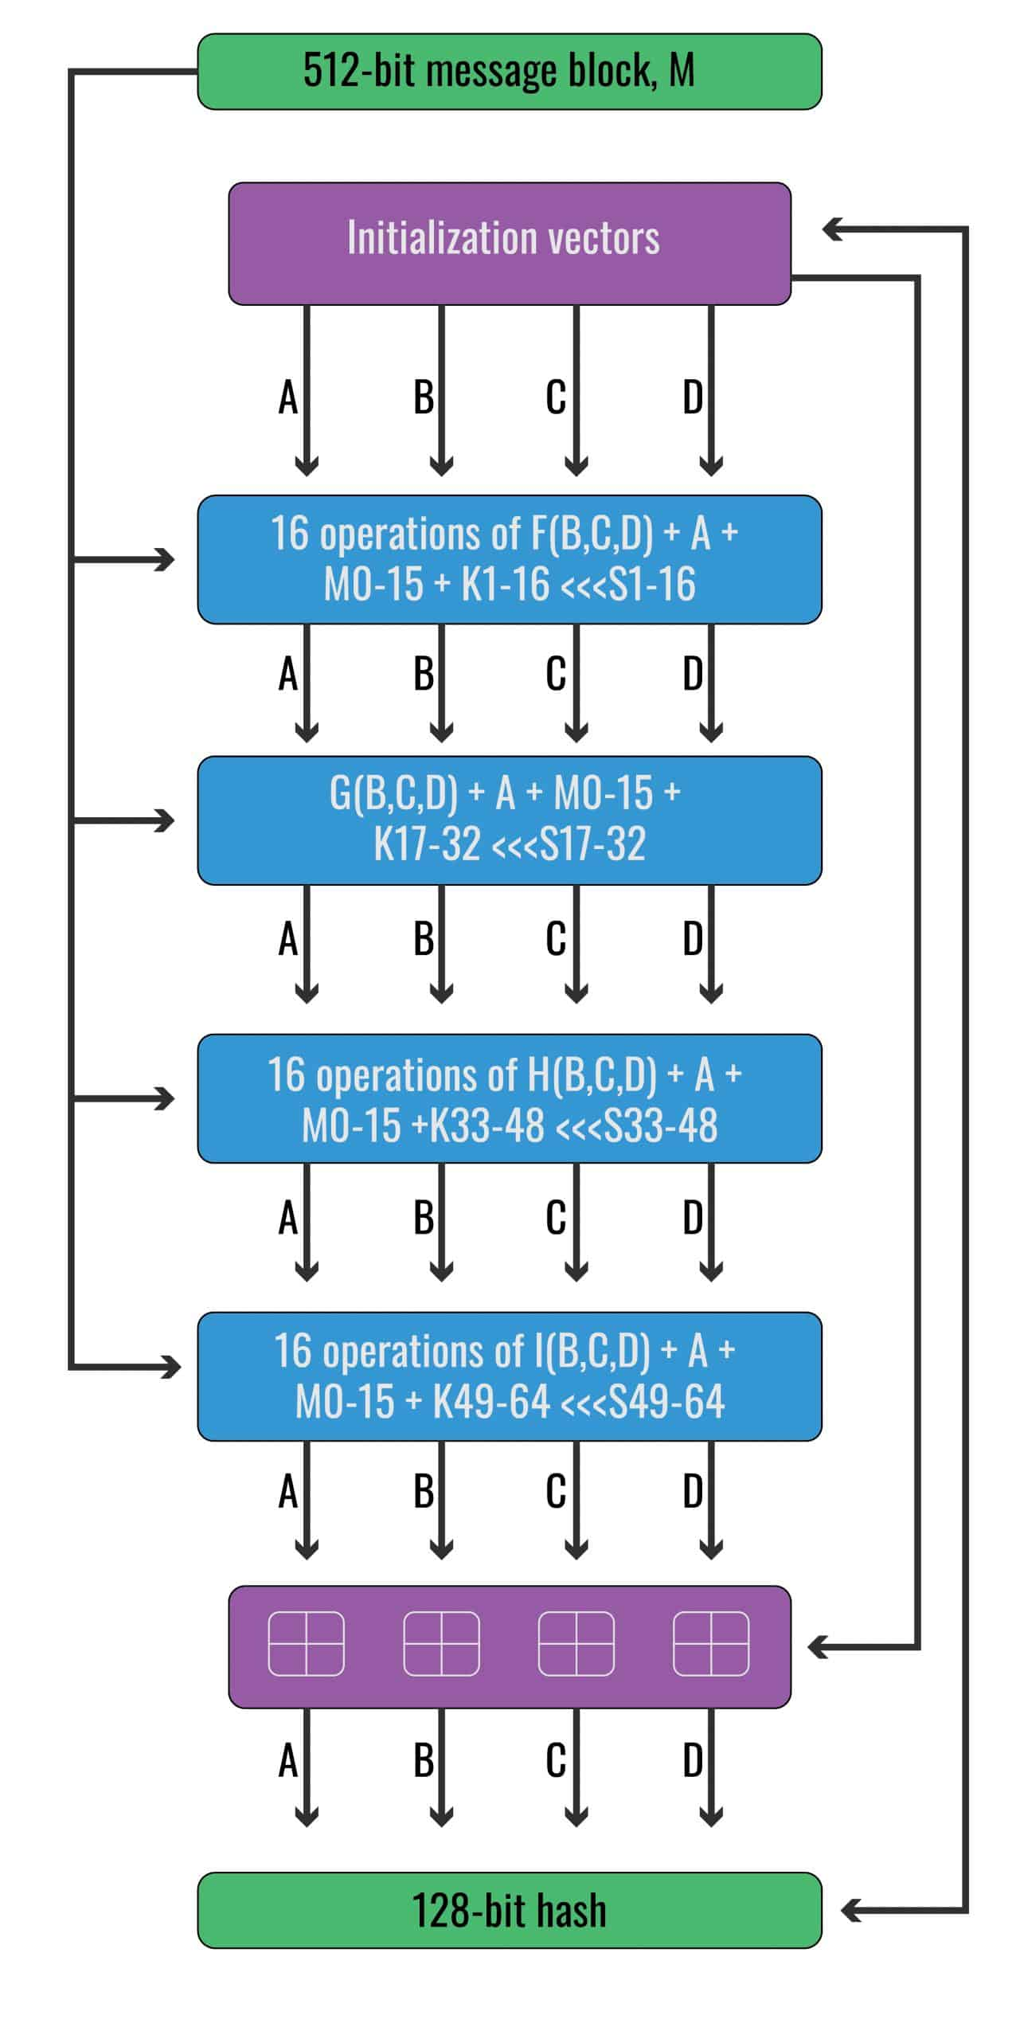

Slide 91
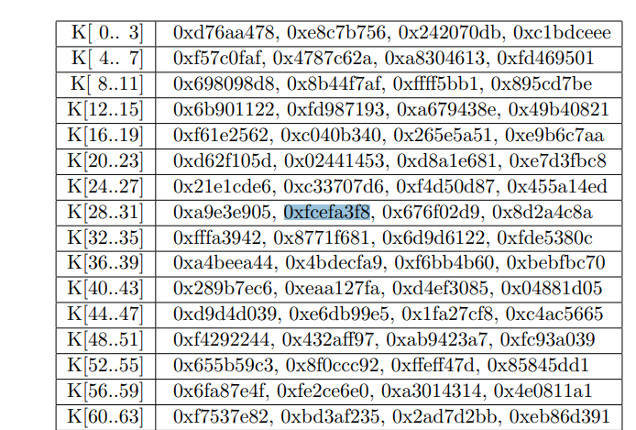
64 constants

Slide 92
Difference between MD4 and MD5
S.N. | Point of Discussion | MD4 | MD5
1 | No of Rounds | 3 | 4
2 | Use of additive constants | Not different in all the iterations | unique additive constant in each iteration.
3 | Process P in round 2
4 | The function g in round 2 | (XY v XZ v YZ) | (XZ v Y not(Z))

Slide 93
Secure Hash algorithm
SHA originally designed by NIST (National Institute of Standards and Technology) in 1993.
When weaknesses were discovered in SHA (now known as SHA-0), a revised version was issued as in 1995 and is referred to as SHA-1.
SHA-1 produces a hash value of 160 bits/40 hex characters /20-bytes
In 2002, NIST produced a revised version of the standard,, that defined three new versions of SHA with hash value lengths of 256, 384, and 512 bits known as SHA-256, SHA-384, and SHA- 512, respectively. Collectively, these hash algorithms are known as SHA-2.
These new versions have the same underlying structure and use the same types of modular arithmetic and logical binary operations as SHA-1.

Slide 94
Working of SHA1: Step 1: Padding
The first step of SHA1 is adding Padding bit to the end of original message to prepare message in multiple of 512 bits.

Slide 95
Step2: Append the length
The length of message excluding the length of padding is now calculated and appended to the end of the padding as 64-bit block. (Message length is 64 bits short of multiple of 512)

Slide 96
Step3: divide the input into 512-bit blocks
The input message is now divided into blocks, each of length 512 bits.

Slide 97

Step4: initialize chaining variables
Now five chaining (IV) variables A-E are initialized.
Each of 32 bit variables produces 160 bits length of message digest.

Slide 98
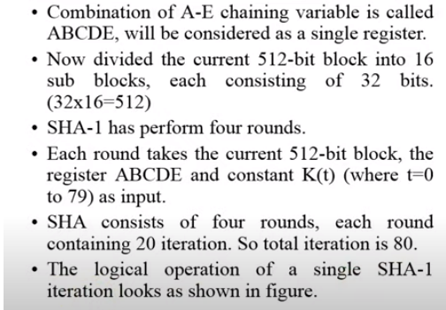
Step5: process block and output

Slide 99
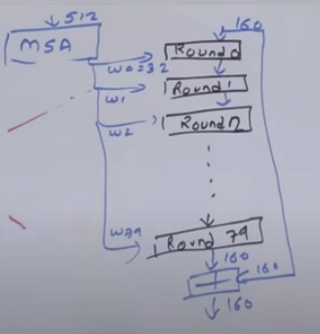

Slide 100
Processing Functions….
SHA1 requires 80 processing functions defined as:
f(t;B,C,D) = (B AND C) OR ((NOT B) AND D) ( 0 <= t <= 19)
f(t;B,C,D) = B XOR C XOR D (20 <= t <= 39)
f(t;B,C,D) = (B AND C) OR (B AND D) OR (C AND D) (40 <= t <=59)
f(t;B,C,D) = B XOR C XOR D (60 <= t <= 79)
Processing Constants....
SHA1 requires 80 processing constant words defined as:
K(t) = 0x5A827999 ( 0 <= t <= 19)
K(t) = 0x6ED9EBA1 (20 <= t <= 39)
K(t) = 0x8F1BBCDC (40 <= t <= 59)
K(t) = 0xCA62C1D6 (60 <= t <= 79)

Slide 101
Processing Message…
This is the main task of SHA1 algorithm which loops through the padded and appended message in 512-bit blocks.
Input and predefined functions:
M[1, 2, ..., L]: Blocks of the padded and appended message
f(0;B,C,D), f(1,B,C,D), ..., f(79,B,C,D) 80 Processing Functions
K(0), K(1), ..., K(79) 80 Processing Constant Words
H0, H1, H2, H3, H4, H5 5 Word buffers with initial values

Slide 102
SHA-1 Framework Continued
Pseudo Code….
For loop on k = 1 to L
(W(0),W(1),...,W(15)) = M[k] /* Divide M[k] into 16 words */
For t = 16 to 79 do:
W(t) = (W(t-3) XOR W(t-8) XOR W(t-14) XOR W(t-16)) <<< 1
A = H0, B = H1, C = H2, D = H3, E = H4
For t = 0 to 79 do:
TEMP = A<<<5 + f(t;B,C,D) + E + W(t) + K(t) E = D, D = C,
C = B<<<30, B = A, A = TEMP
End of for loop
H0 = H0 + A, H1 = H1 + B, H2 = H2 + C, H3 = H3 + D, H4 = H4 + E
End of for loop
Output:
H0, H1, H2, H3, H4, H5: Word buffers with final message digest

Slide 103
SHA1 Algorithm

Slide 104
SHA 512
The algorithm takes as input a message with a maximum length of less than 2¹²⁸ bits and produces as output a 512-bit message digest.
The input is processed in 1024-bit blocks.
Total no of Rounds=80 (0-79)
Each Round Consists of a constant K.
Buffers=8
Each Buffer Size=64 bit
The processing consists of the following steps:

Slide 105
Steps
Appending padding bits.
Append length.
Initialize the Buffer.
Process the message in 1024 bit (128-bit word blocks)
Output the final state values as the resulting hash.

Slide 106
Step1 padding
We add padding bits to original message.
Aim is to make the length of original message is equal to a value , which is 128 bit less than an exact multiple of 1024.
The Padding is always added even if the message is of desired length already.

Slide 107
SHA-512: Step 2 Append length:
A block of 128 bits is appended to the message.
It contains the length of the original message (before the padding).
The outcome of the first two steps yields a message that is an integer
multiple of 1024 bits in length.
The expanded message is represented as the sequence of 1024-bit blocks M₁, M₂, ....M_{N}, so that the total length of the expanded message is N * 1024 bits.

Slide 108
Step 3 Initialize hash buffer:
A 512-bit buffer is used to hold intermediate and final results of the hash function.
The buffer can be represented as eight 64-bit registers (a, b, c, d, e, f, g, h).
These registers are initialized to the following 64-bit integers (hexadecimal values):
a = 6A09E667F3BCC908 e = 510E527FADE682D1
b = BB67AE8584CAA73B f = 9B05688C2B3E6C1F
c = 3C6EF372FE94F82B g = 1F83D9ABFB41BD6B
d = A54FF53A5F1D36F1 h = 5BE0CD19137E2179

Slide 109
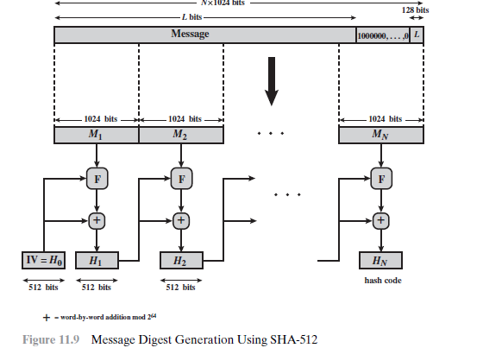
SHA-512

Slide 110
SHA-512
Step 4 Process message in 1024-bit (128-word) blocks:
Copy the above variables into corresponding lowercase variable a-f.
Divide the current 1024 bit block into 16 sub-blocks, each subblock contains 64 bits.
Now we have 80 rounds. In each round, We process all the 16 sub-blocks belonging to a block of 1024 bits.
The inputs to each block are
All the 16 sub blocks , designated as W.
The variable a-h
Some constants designated as K.

Slide 111
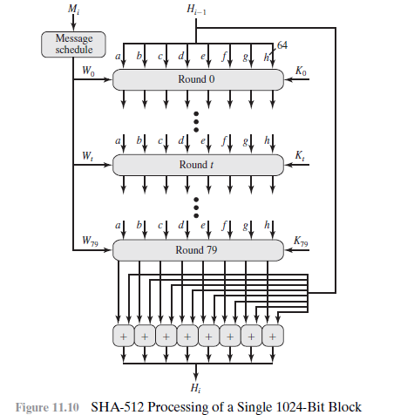

Slide 112
SHA-512
Each round takes as input the 512-bit buffer value, abcdefgh, and updates the contents of the buffer.
At input to the first round, the buffer has the value of the intermediate hash value, H_{i-1}. Each round t makes use of a 64-bit value W_{t}, derived from the current 1024-bit block being processed (M_{i}).
Each round also makes use of an additive constant K_{t}, where 0 ≤t ≤79 indicates one of the 80 rounds.
The output of the eightieth round is added to the input to the first round (H_{i-1}) to produce H_{i}.
The addition is done independently for each of the eight words in the buffer with each of the corresponding words in H_{i-1}, using addition modulo 2⁶⁴.

Slide 113
Step 5 Output:
After all N 1024-bit blocks have been processed, the output from the Nth stage is the 512-bit message digest

Slide 114
SHA-512
We can summarize the behavior of SHA-512 as follows:
H₀ = IV
H_{i} = SUM₆₄(H_{i-1}, abcdefgh_{i})
MD = H_{N}
where
IV = initial value of the abcdefgh buffer, defined in step 3
abcdefgh_{i} = the output of the last round of processing of the ith message
block
N = the number of blocks in the message (including padding and
length fields)
SUM64 = addition modulo 264 performed separately on each word of the pair of inputs
MD = final message digest value

Slide 115
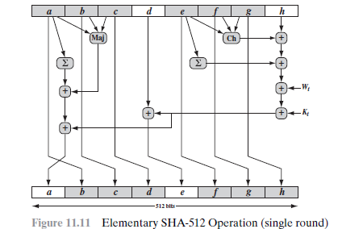
SHA-512 Round Function: Let us look in more detail at the logic in each of the 80 steps of the processing of one 512-bit block.

Slide 116
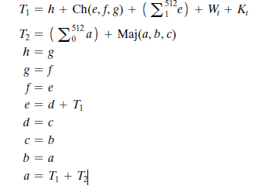
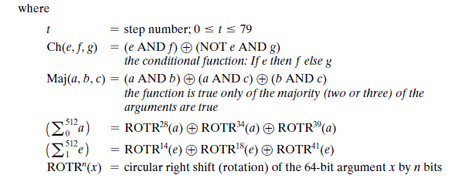
SHA-512

Slide 117
SHA-512
W_{t} = a 64-bit word derived from the current 1024-bit input block
K_{t} = a 64-bit additive constant
+ = addition modulo 2⁶⁴
Two observations can be made about the round function.
Six of the eight words of the output of the round function involve simply permutation (b, c, d, f , g, h) by means of rotation. This is indicated by shading in Figure 11.11.
Only two of the output words (a, e) are generated by substitution. Word e is a function of input variables (d, e, f , g, h), as well as the round word W_{t} and the constant K_{t}. Word a is a function of all of the input variables except d, as well as the round word W_{t} and the constant K_{t}.
It remains to indicate how the 64-bit word values W_{t} are derived from the
1024-bit message.
The first 16 values of Wt are taken directly from the 16 words of the current block.

Slide 118
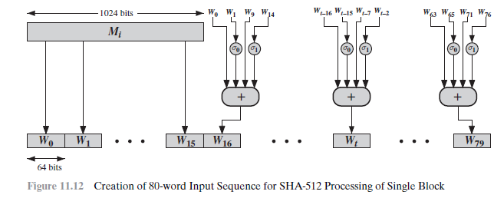
SHA-512

Slide 119
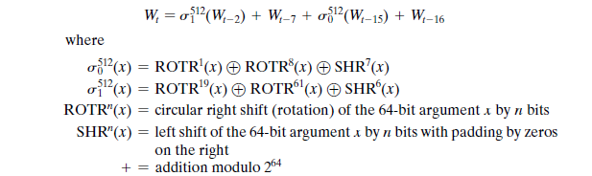
SHA-512
The remaining values are defined as:
In the first 16 steps of processing, the value of W_{t} is equal to the corresponding word in the message block.
For the remaining 64 steps, the value of W_{t} consists of the circular left shift by one bit of the XOR of four of the preceding values of W_{t} with two of those values subjected to shift and rotate operations.

